Slide 1
1-dimensional traveling waves in neural minicolumns
Vincent Baker
Drexel University Department of Physics

Slide 2
Summary
Computational exploration of 1-D traveling waves in neural minicolumns
Columns with mostly local connectivity and a mix of excitatory and inhibitory neurons exhibit traveling waves from random stimulation
Wave propagation speed depends on synaptic delays but also column topology. Wave propagation velocity is not linear wrt action potential velocity down a synapse, and 1-D traveling waves can propagate more slowly than individual action potentials.
Paper #2:
Dynamics of column ensembles (“macrocolumns” or “hypercolumns”)
Exploration of computational properties of column ensembles for visual or auditory processing using liquid state machine paradigm

Slide 3
Introduction
Traveling waves of cortical neuron activation have been observed in vivo, in vitro and in silico. Proposed functions of these traveling waves include motor coordination, place field coordination in the hippocampus, and spatiotemporal processing in the visual cortex. Advanced experimental techniques that achieve the required spatial and temporal resolution to capture the mesoscopic traveling waves have focused on lateral activity near the cortical surface, and simulations of traveling waves in a 2-D sheet of neurons have been performed. In this work we explore the dynamics of traveling waves along the vertical column structures found in the cortex.
We find that 1-D traveling waves can propagate in simulated neural microcolumn structures with certain properties including distance-dependent connectivity and a mix of excitatory and inhibitory neurons. We observe wave properties including creation from background stimulus, annihilation between waves, and a wave group velocity that is determined by both the neural phase velocity (action potential propagation speed down a synapse) and the column topology. The topological dependence of wave speed is especially interesting as it may contribute to the functional organization of the cortex into microcolumns.

Slide 4
Methods

Slide 5
Neuron and Synapse Dynamics
Izhikevich model for neuron dynamics
2-D model that captures key dynamical behavior
Randomization of model parameters
Excitatory and inhibitory neurons
Synapse response model is an exponential decay with a delay. Delay is proportional to distance with constant of proportionality κ
Simulated in MATLAB

Slide 6
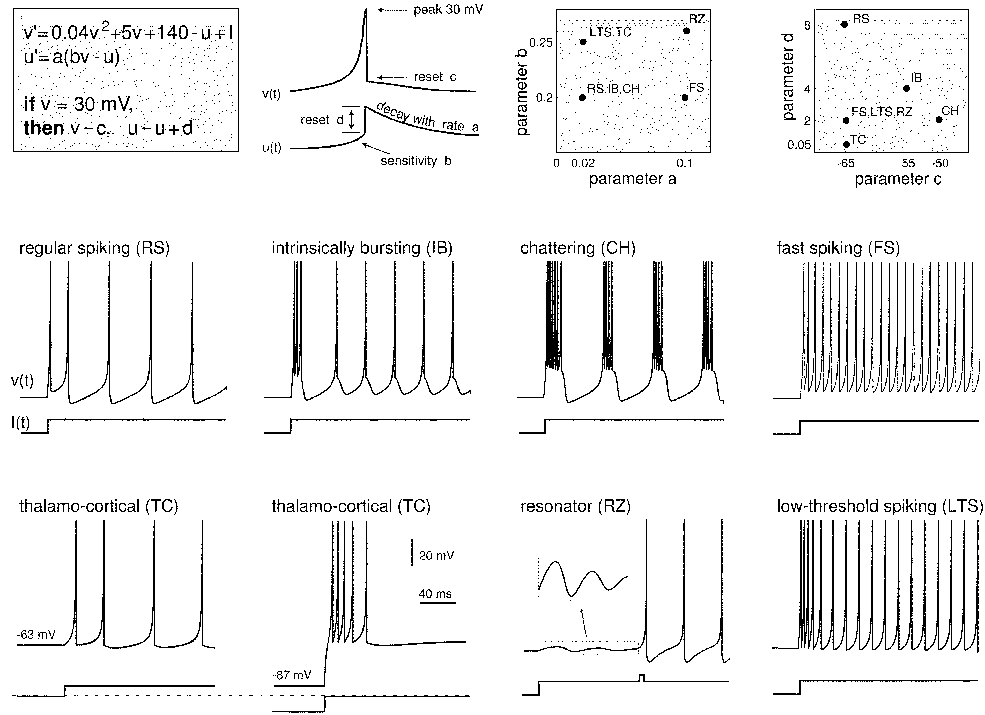
Izhikevich model of neuron dynamics
Differential equations with threshold and reset
Simple system for exploring two-dimensional dynamics
The Izhikevich model can replicate common spiking patterns with the appropriate choice of parameters (Izhikevich 2003)

Slide 7
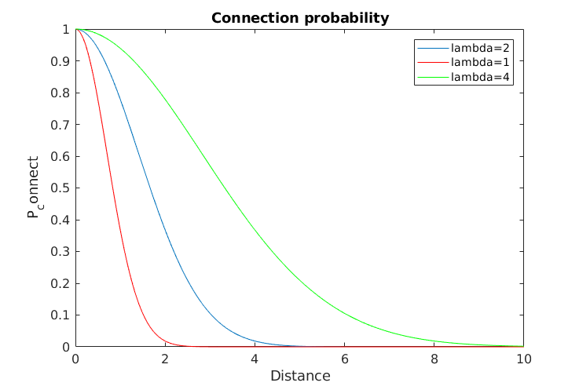
Neuron Connectivity
Distance-based exponential connection probability
Lots of short range connections, sparse long-range connections

Slide 8
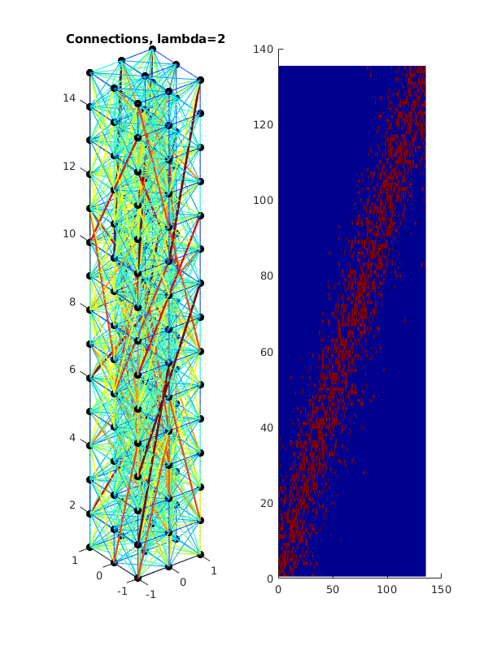
Column structure
Neurons on a unit spacing
Column topology defined by x-y cross section and z height, waves travel along z axis
Neurons are connected probabilistically using distance model with exponential decay, high local connectivity with sparse long-distance connectivity
Z axis
3x3x15 column

Slide 9
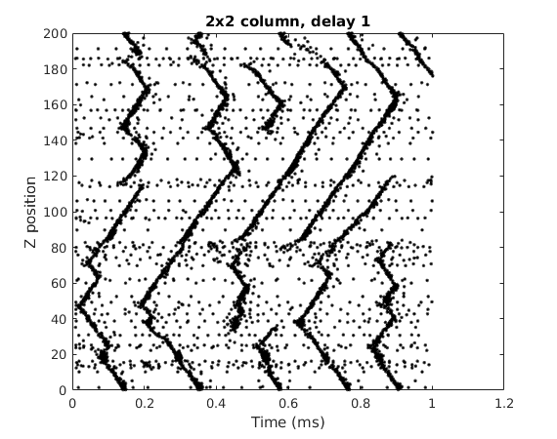
Traveling waves
We plot the neuron firings over time, with one black mark per firing event
We plot each neuron firing at the Z position of the neuron. There are multiple neurons at each Z position so there can be overlapping marks
Wave collision and annihilation
Background firing activity defined as firing events that are not part of a wave structure
Traveling wave initiation

Slide 10
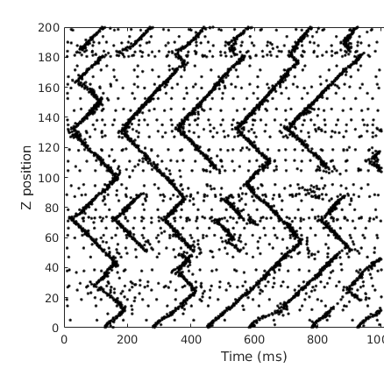
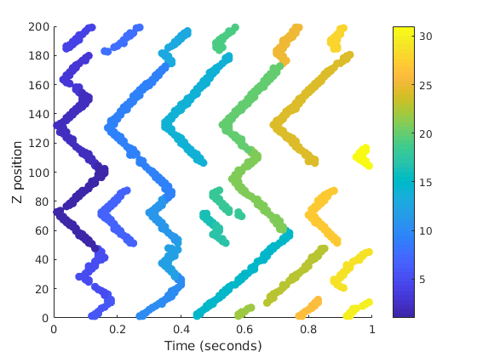
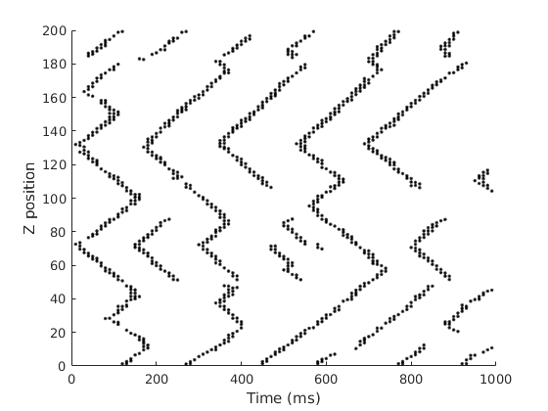
Wave detection and labeling
Firing events
High density regions
Waves
Filter
ID
Detection process first filters raw firing events to discard background firing
Plane sweep algorithm identifies wave initiation points, groups firing events into waves

Slide 11
Results

Slide 12
Properties
Wave initiation from background stimulus
Preferential initiation sites
Dependent on strength of stimulus and connection strength
Wave annihilation
Propagation velocity
Dependent on both delay parameter and column topology
Not linear in κ. The wave propagation speed is not determined entirely by the action potential propagation speed.

Slide 13
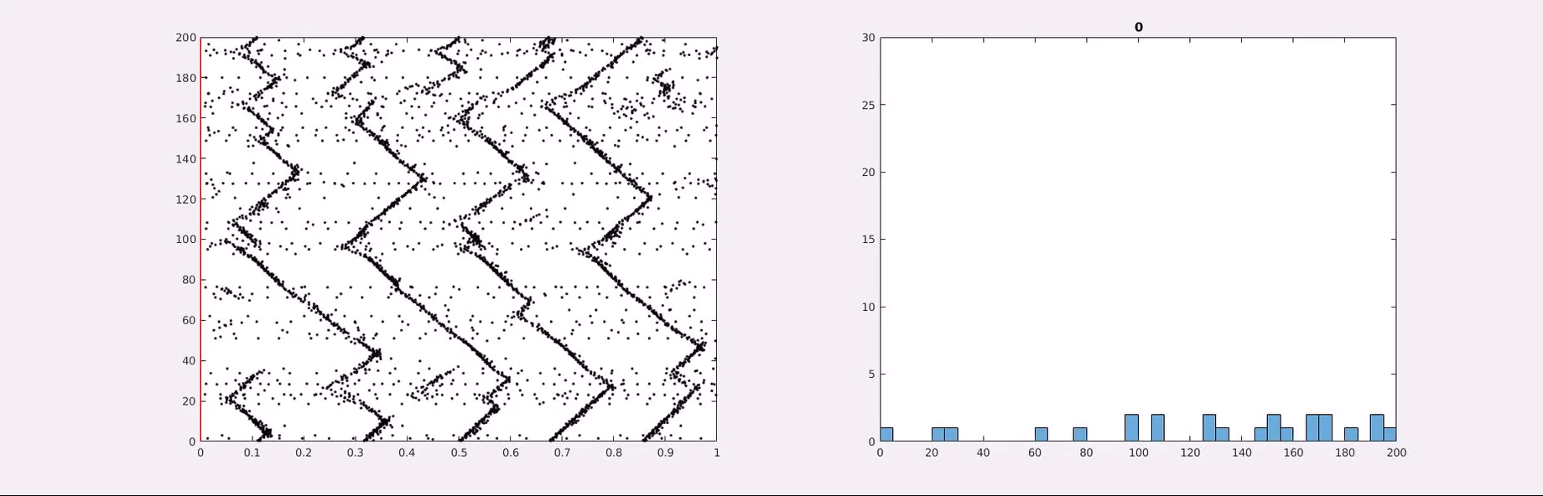
Wave initiation
Traveling waves emerge from uniform random stimulus of entire column
Certain sites seem to be preferential for wave initiation

Slide 14
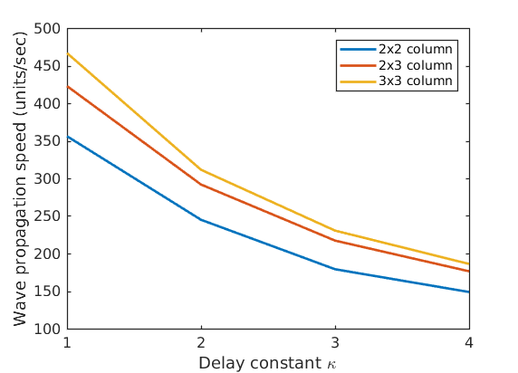
Wave propagation speed
Thicker columns increase wave propagation speed
Wave propagation slows at higher κ, but it’s not linear. With κ=1 we would expect propagation speed 1000 units/second, but in a 2x2 column it’s a third of that value.

